Slide 1
MUSIC CLASSIFICATION
ARTIFICIAL INTELLIGENCE
Instructor: Yan Ding
Team Members: My Nguyen, Sam Downs, Jasmine Roach, Ryan Young

Slide 2
Understanding the problem
Music Classification. How does Spotify keep your music going after your queue runs out or playlist ends? There’s a number of ways they could do this, but what if we used machine learning algorithms to classify them based on the sound of the music itself.
Using the library pyAudioAnalysis, we can extract a large amount of information from the waveform of an audio file, and use that information to train models and classify the music.
For the purposes of this project, we are using the gtzan music data classification set of data, which includes 30 second clips of 10 different music genres.

Slide 3
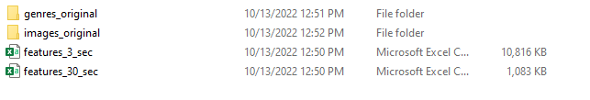
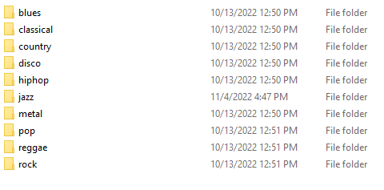
Collect data
Source: https://www.kaggle.com/datasets/andradaolteanu/gtzan-dataset-music-genre-classification
Each genre has one hundred, thirty second sound clips separated into their individual folders.

Slide 4
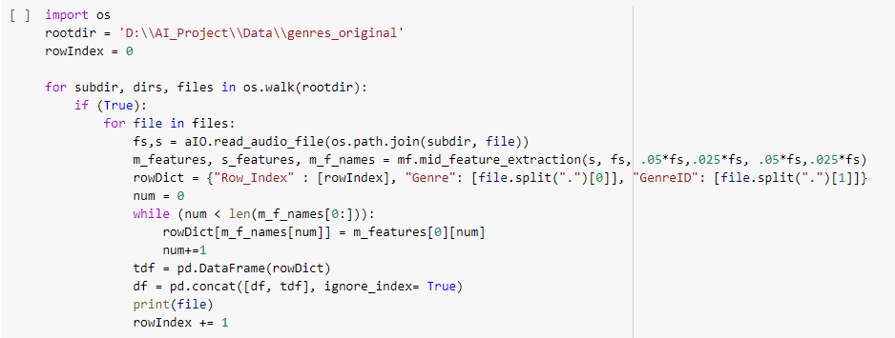
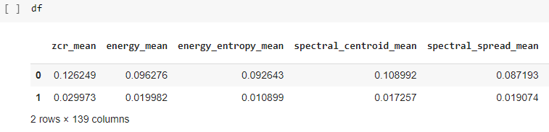

Prepare data
mid_feature_extraction is the method used to get information from the music clip waveform. The information is put into a dataframe.
A small part of the dataframe result:

Slide 5
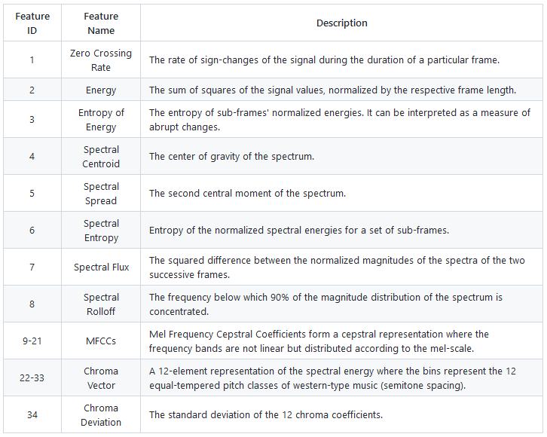

Slide 6
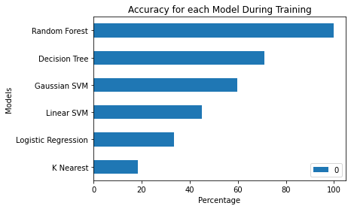
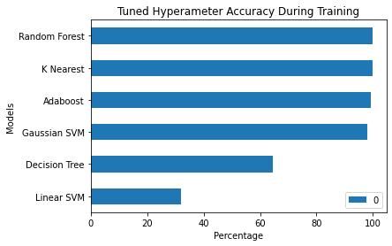
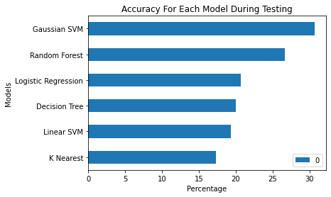
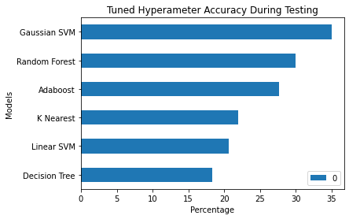
Notes:
Note the differences in the results, the overfitting, underfitting, etc, why we need to get more data!

Slide 7


Train model

Slide 8
Test model

Slide 9
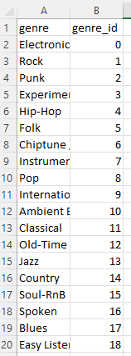
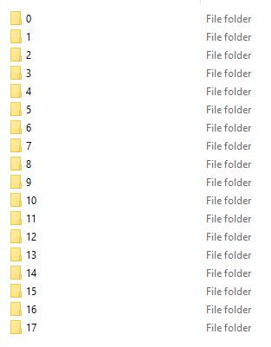

Gathering More Data
Source: https://www.kaggle.com/datasets/asisheriberto/music-classification-wav
This second datasrouce is formatted similarly to the gtzan set, with soundclips separated by genre. There are more genres here than in the gtzan set, but it is still expanding our dataset to try reducing the overfitting issue found.

Slide 10
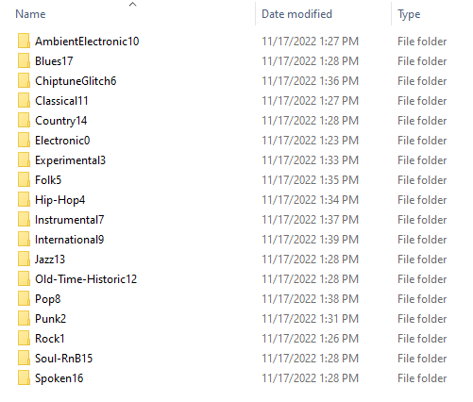
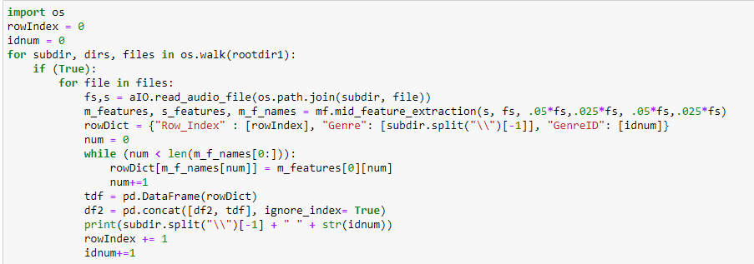
Preparing the New Data
A little more preparation was needed for this dataset to make it usable with what we already had. After the name changes and other preparation was done, the process was the same as before.

Slide 11
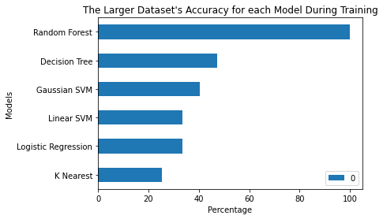
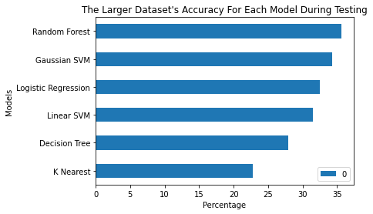
Comparing the train/test of the old data to the new data

Slide 12
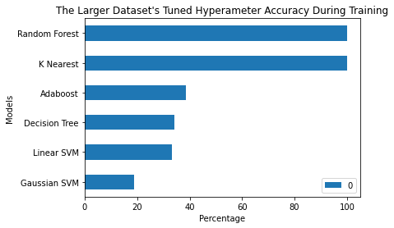
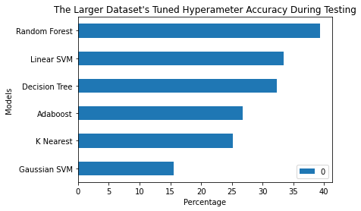
Comparing the Hyperparameter tuning of the train/test of the old data to the new data

Slide 13
Lessons Learned
Data collection and preparation takes a long time, getting things ready for training took us longer than expected.
This project taught us complex coding, like looping through files and their subdirectories, teaching us general complex data handling.

Slide 14
Questions?

